Slide 1
Equilibrium of Firm and Types of Markets
Copyright@ Ashis Kumar Pradhan

Slide 2
Meaning of Market and its Types
Meaning of Market
Market is a system where the price is being determined because of the influence of buyers and Sellers.
Market can be categorized as
On the basis of area
On the basis of time period
On the basis of transaction
On the basis of regulation
On the basis of business
On the basis of Competition
Types of Market
On the basis of area: (a) Local Markets (b) Regional markets (c) National markets (d) International Markets
On the basis of time period: (a) short-period market (b) Long period Market
On the basis of transaction (a) Spot Market (b) Future market
On the basis of regulation (a) Regulated Market (b) Unregulated Market
On the basis of business (a) Wholesale Market (b) Retail Market
On the basis of Competition (a) Perfect Competition (b) Imperfect Competition

Slide 3
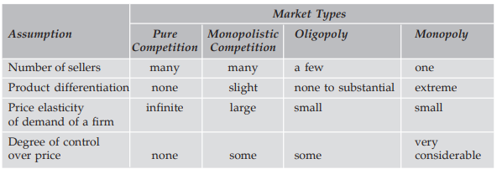
Types of Market Structure
Theoretically, market structures are categorized as
Perfect Competition
Imperfect Competition
a. Monopoly
b. Monopolistic Competition
c. Duopoly

Slide 4
Related Concepts
Total Revenue = Price × Quantity
Average Revenue= Total Revenue/ Quantity = Price
Marginal Revenue= ΔTotal Revenue/ ΔQuantity
Relationship between Marginal Revenue, Average Revenue and Elasticity of Demand
Marginal Revenue= Average revenue (e-1/e)

Slide 5
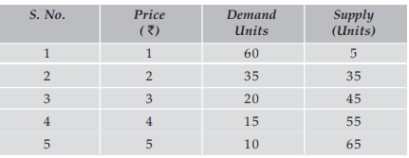
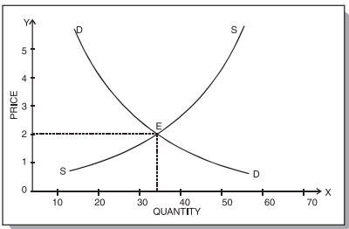
Determination of Prices

Slide 6
Changes in demand and Supply
We will discuss about four possible changes in quantity demand and supply are:
1. Increase in Demand
2. Decrease in Demand
3. Increase in Supply
4. Decrease in Supply

Slide 7
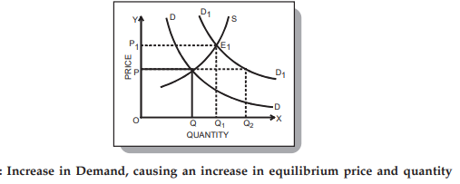
Increase in Quantity Demand

Slide 8
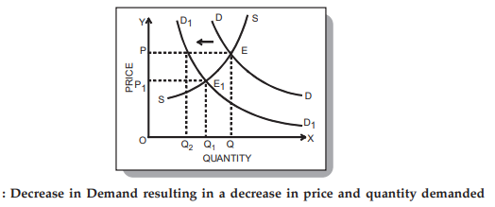
Decrease in Quantity Demand

Slide 9
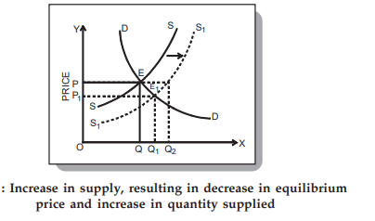
Increase in Quantity Supply

Slide 10
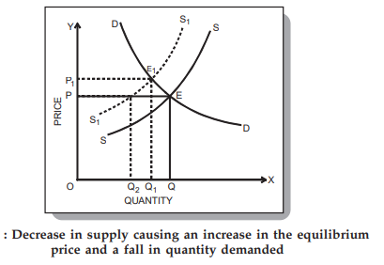
Decrease in Quantity Demand

Slide 11
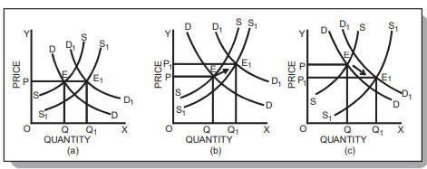
Simultaneous changes in Quantity Demand and Supply

Slide 12
THANKS!
Any questions?

